Slide 1

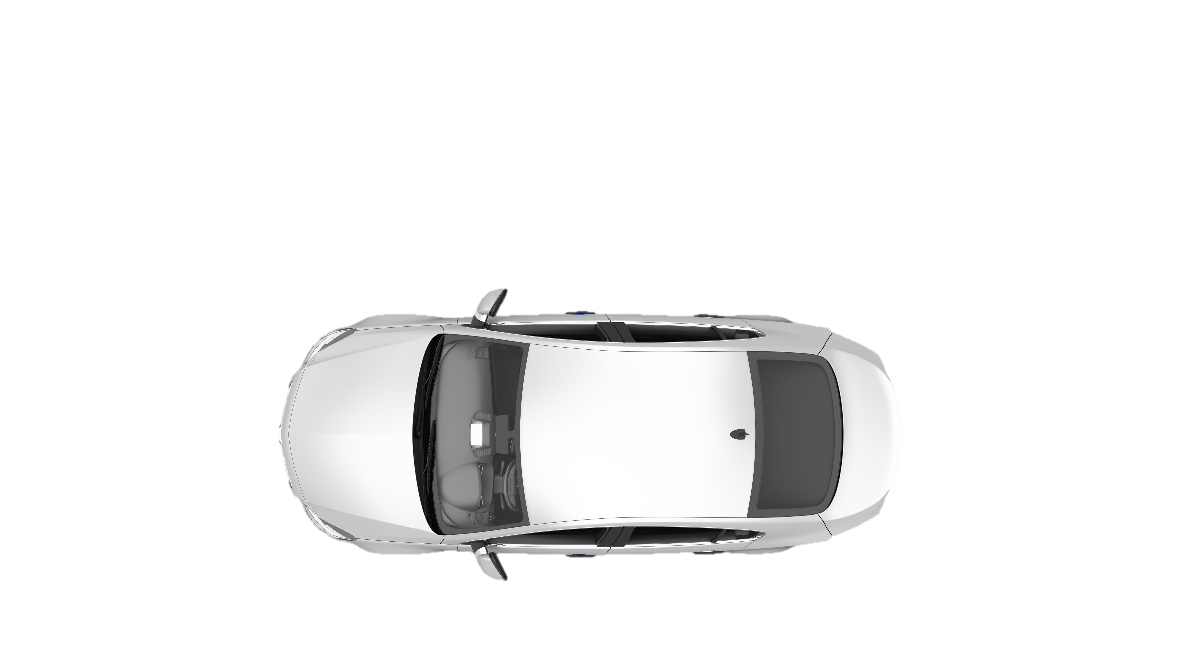


COLLABORATING
COMPETING
GROWING

Slide 2
WHAT IS A CLUSTER?
“A cluster is a geographical concentration of associated companies and institutions in a particular field, linked by common and complementary characteristics, which compete but also cooperate”
Michael Porter

Slide 3



WHY DO CLUSTERS WORK?
They trigger collaboration and synergy between the triple helix (government, academia and companies), and generate:
Innovation
Growth
Development
Competitiveness

Slide 4

WHO ARE WE?
The Nuevo Leon Automotive Cluster (CLAUT) is a civil association created in 2007 with the mission of promoting the competitiveness and growth of the automotive industry in the region.
It has national and international recognition as one of the pioneering organizations in the clustering process in Mexico and Latin America; and for being a role model for excellence in the implementation of its management processes.

Slide 5


MAIN BENEFITS
Access to government funds and financing options
Benchmarking & Networking
Enabling the transition to the Vehicle of the Future
Possibility of integration into the production supply chain
Opportunity to achieve goals together, difficult to accomplish individually
Specialized training and optimization of training costs
Synergies

Slide 6



ABOUT US
Vision
Mission
Values
To be recognized in the automotive industry for the high degree of competitiveness, technology and sustainable growth in Nuevo Leon, contributing to the development of Mexico
To promote the competitiveness and growth of the automotive sector in the region through collaboration, interconnection and synergies between government, academia and companies.
Integrity
Responsibility
Collaboration
Innovation
Customer Focus

Slide 7



STRATEGIC OBJECTIVES
2025-2030
ANTICIPATING INDUSTRY TRENDS AND DRIVING EXCELLENCE
PROMOTING INNOVATION AND TECHNOLOGY
STRENGTHENING LOCAL AND REGIONAL VALUE CHAINS
INCREASE THE LEVEL OF INFLUENCE IN THE PUBLIC SPHERE
SHAPING THE FUTURE BY BRIDGING TALENT GAPS

Slide 8









MILESTONES
2005
Citizen Council for the Development of the Automotive Industry of Nuevo Leon is formed
July 2007
The Automotive Cluster is officially constituted
Nov. 2014
First Edition
April 2016
Inauguration DRIVEN/CLAUT Innovation Center
2019
Saltillo Chapter becomes a new Cluster
March 2014
First Edition
March 2007
Beginning of operations
September 2011
First Edition
June 2014
Gold Label from ESCA (European Secretariat for Cluster Analysis) is obtained
March 2018
The Tooling Center is launched
June 2019
CLAUT, with other associations, founds the Network of Clusters of the Automotive Industry of Mexico
June 2023
First Edition

Slide 9
















BOARD

Slide 10
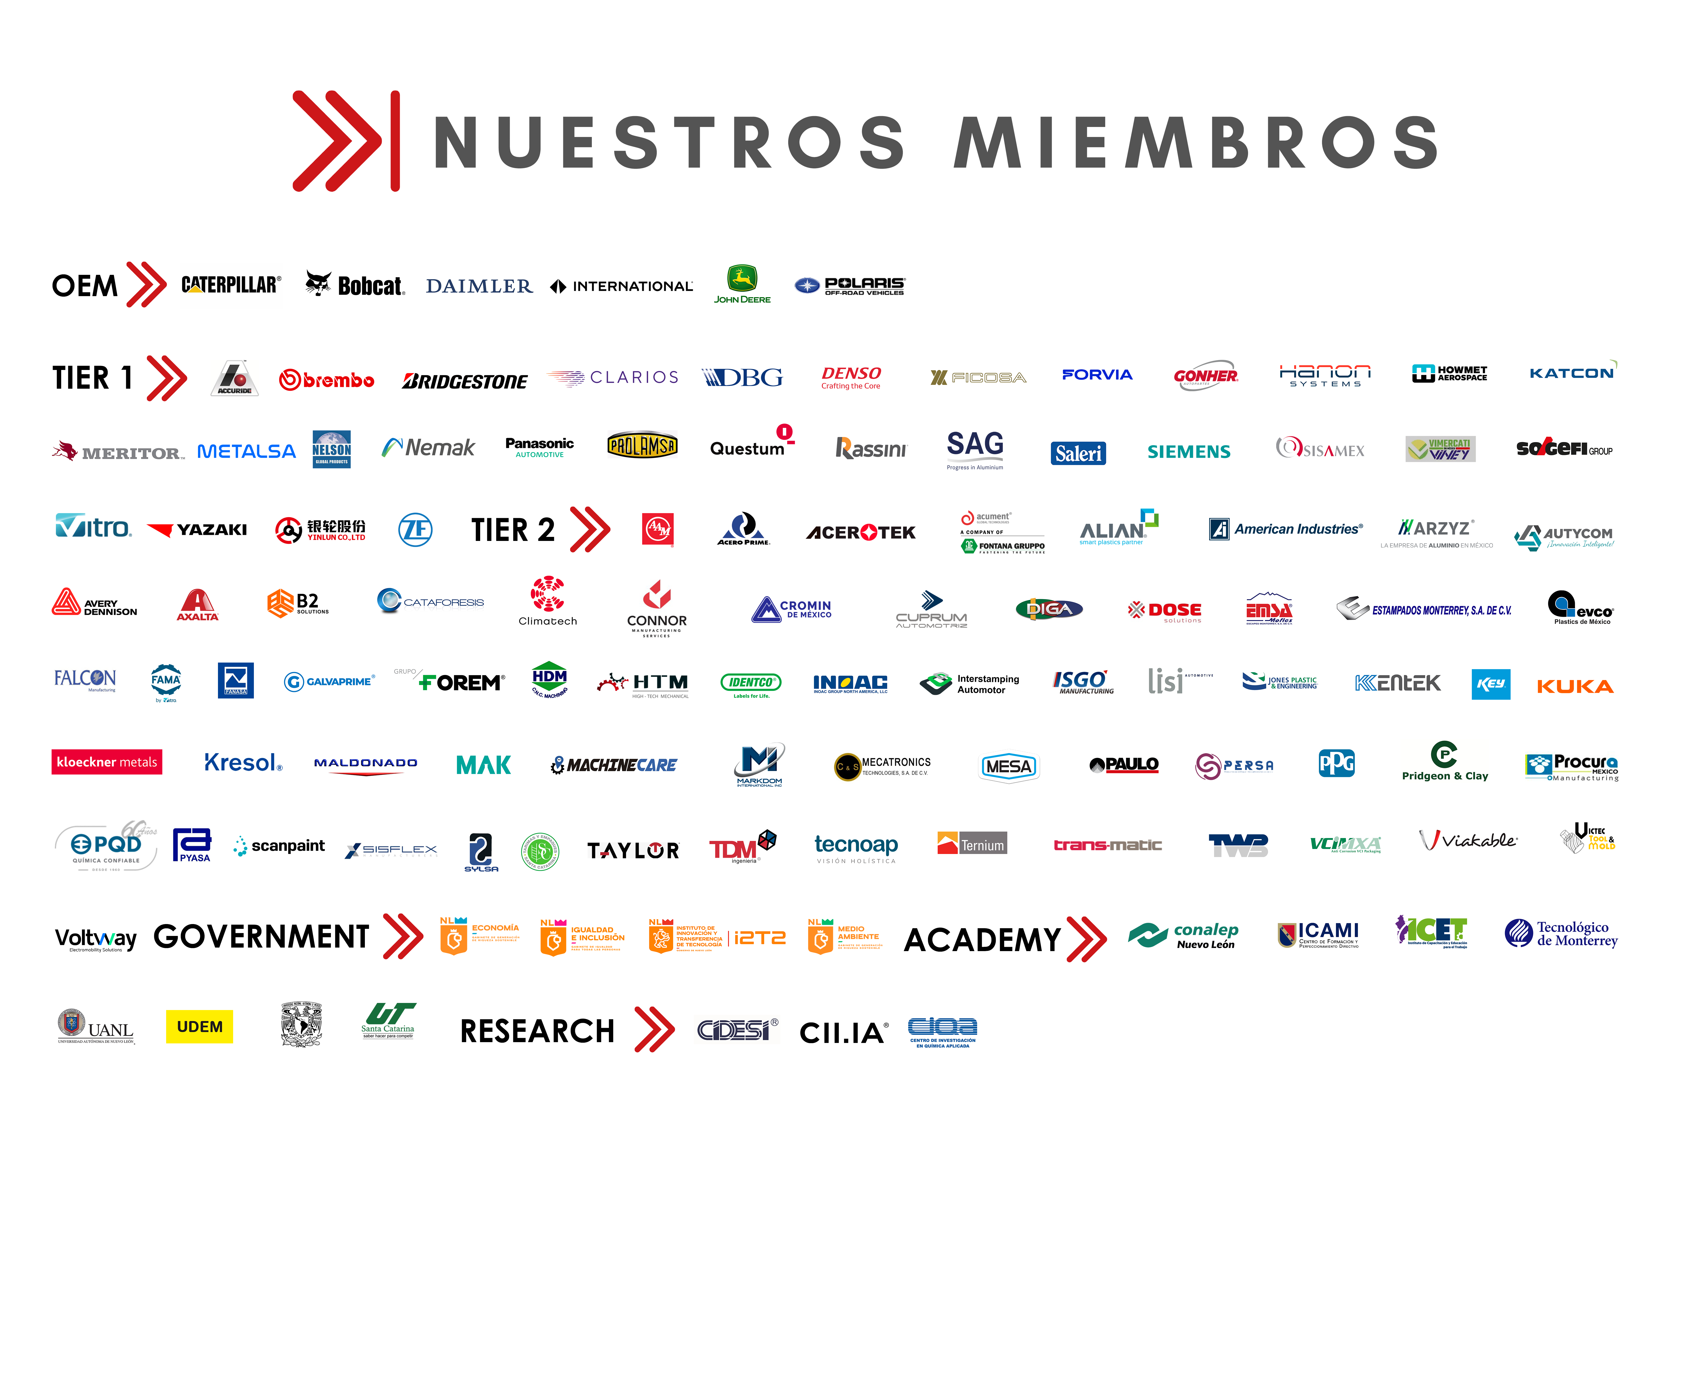
MEMBERS

Slide 11




















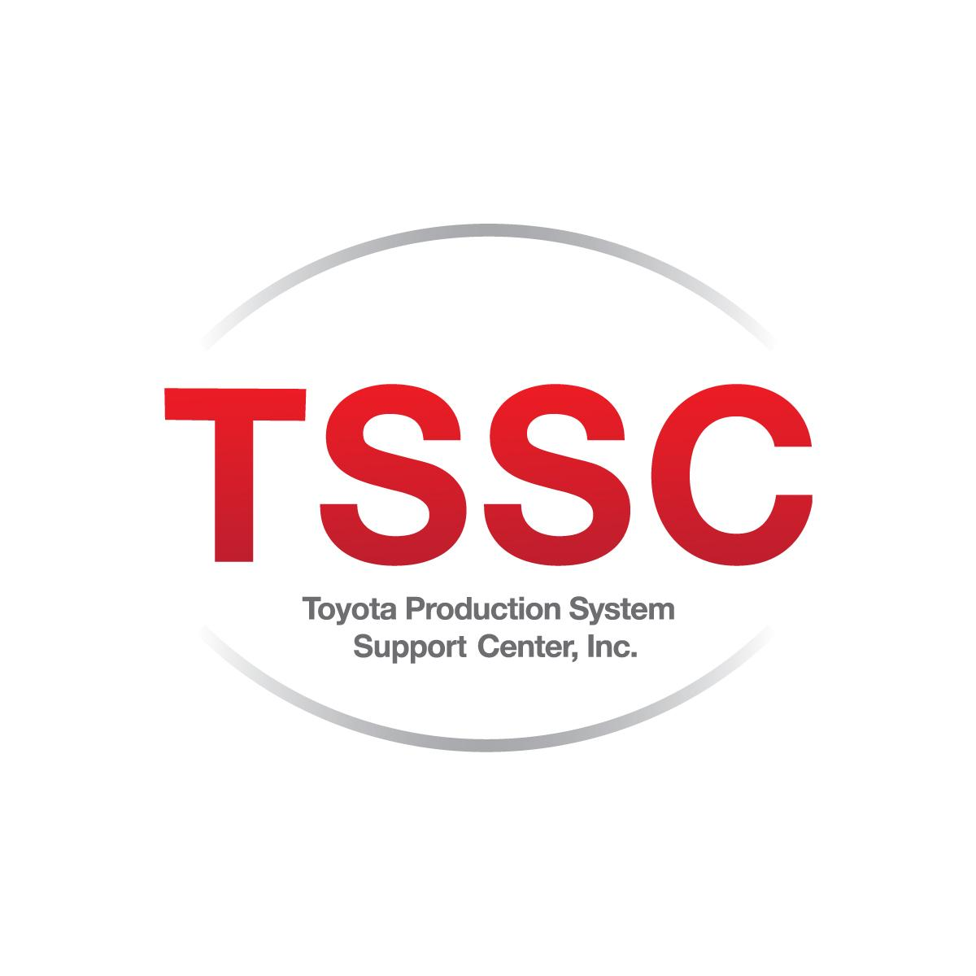




STRATEGIC ALLIANCES

Slide 12

















COMMERCIAL ALLIES AND SPONSORS

Slide 13


















Supply Chain
Sustainability
Commercial
Human Development
Training
Supplier Development
Labor
Quality
Finance
Innovation
Operations
Energy
Tier 2
BOARD
Foreign Trade
Industrial Safety
Maintenance
Human Development
Social Responsibility
COMMITTEES

Slide 14
ABOUT THE
COMMITTEES
Share best practices
Benchmarking visits to companies of interest (internal and external)
Who attends?
Business Leaders
Academics
Government representatives
Organize conferences and training programs on topics of interest
Identify and prioritize common problems
Create synergies and projects to address these problems

Slide 15






WORK COMMITTEES
FINANCE
OBJECTIVE: Provide financing options for companies, share best practices and updates in the administrative, fiscal and financial areas, to generate growth and expansion in organizations.
PROJECTS: Search for Financing and Linkage options with Commercial Institutions Support on the subject of VAT Refunds Indicator measurement system for the Admin area and Finance
PERIODICITY: Bimonthly
SUPPLIER DEVELOPMENT
OBJECTIVE: Promote the commercial integration of the Automotive Industry in the region to increase national content, through collaboration, linkage and synergies between the Government, Academia and Companies
PROJECTS: Access to financial mechanisms business facilitation with T2 Requirements mapping and Supplier Catalog Business Bonding Platform
PERIODICITY: Monthly
FOREIGN TRADE
OBJECTIVE: Support competitiveness and updating knowledge in customs matters, providing certainty to optimize and promote traceability in Foreign Trade compliance
PROJECTS : Petit Foreign Trade Committee Foreign Trade Control Board Updates to rules and documents for Trade Compliance Advantages of the Colombia Bridge
PERIODICITY: Monthly
TIER 2
OBJECTIVE: Promote the development of Tier 2 companies by reaching the competitiveness required by the market, synergizing with the Nuevo Leon Government and the Academy
PROJECTS : CLAUT Action Warehouse project as a distribution center Support in certifications Access to government funds and credit
SUBCOMMITTEES: Commercial T2 I 4.0 Supplier Development
PERIODICITY: Monthly
COMMERCIAL
OBJECTIVE Promote the commercial growth of Tier 2 affiliated companies through networking activities inside and outside the cluster and through the creation of joint strategies and action plan.
PROJECTS: Trade missions Promotion and assistance to events Business coaching Liaison with purchasing companies CLAUT Action Networking
PERIODICITY: Monthly
I4.0 SUPPLIER DEVELOPMENT
OBJECTIVE: Develop a reliable panel of Industry 4.0 suppliers of automation and software companies that have the capacity to contribute to the process of incorporation into the fourth industrial revolution for our associated companies (OEMs, Tier 1 and TiER 2).
PROJECTS: Business Bonding Creation of training programs Collaborative work in Industry 4.0 project
PERIODICITY: Monthly

Slide 16






WORK COMMITTEES
4.0
SUSTAINABILITY
OBJECTIVE: Minimize the negative environmental impact of manufacturing operations, mainly zero discharge, circular economy and carbon neutral.
PROJECTS: Environmental Legislation and State Regulation Green Taxes Circular Economy Water scarcity in the state LCBAM Initiative Sustainability Seminar
SUBCOMMITTEES Energy Security Social responsibility
PERIODICITY: Bimonthly
ENERGY
OBJECTIVE: : Provide the tools for energy efficiency, update of laws as well as the guide for energy management systems.
PROJECTS: Renewable energies, hydrogen Wholesale Electricity Market and/or Network Code Energy efficiency Individual follow-up energy generators Energy Leaders Diploma Interuniversity Energy Saving Projects
PERIODICITY: Monthly
INDUSTRIAL SAFETY
OBJECTIVE: Prevent accidents and labor incidents in the companies of the associates, minimizing the risks in the operation.
PROJECTS: NOM-035: stress and mental health WCM Security Pillar SBC (Common Based Security) behaviors Machinery Safety Devices Certification ISO-45001 Lead Auditor Security Alerts
PERIODICITY: Bimonthly
SOCIAL RESPONSIBILITY
OBJECTIVE: : Promote Social Responsibility in the committee members' organizations through best practices and alliances with organizations.
PROJECTS: Annual Best Practices Award Live Values Contest Volunteer Activity Breast Cancer Prevention Program Social Responsibility indicators measurement system
PERIODICITY: Monthly
SUPPLY CHAIN
OBJECTIVE: Create robust and efficient supply chains that increase the global competitiveness of companies and the region, that guarantee a reliable supply and that encourage investment in Nuevo Leon.
PROJECTS: Supply Chain Best Practices Measurement Instrument Transportation Industry Strategies in Mexico Demand Driven Supply Chain Risk Management
PERIODICITY: Monthly
INNOVATION
OBJECTIVE: Promote the development of a regional innovation ecosystem that enhances the capacity of associated companies.
PROJECTS: Infrastructure integration for component validation Solution Development Disruptive innovation of subsystems Alignment of academic programs with industry Mobility Event
PERIODICITY: Monthly
INDUSTRY 4.0
OBJECTIVE: : Promote actions that help companies to adopt the different technologies that make up Industry 4.0, fostering synergies between the participants.
PROJECTS: Interorganizational collaborative projects Integration of Industry 4.0 Suppliers Catalog Benchmarking inside and outside the automotive sector
PERIODICITY: Monthly

Slide 17






WORK COMMITTEES
OPERATIONS
OBJECTIVE: Raise performance by raising awareness of operational excellence and understanding and sharing successful manufacturing and business methodologies.
PROJECTS: Best Practice site visits Benchmark Tour CLAUT Award (Continuous Improvement) Annual Assembly of Operation
SUBCOMMITTEES Quality Maintenance
PERIODICITY: Monthly
QUALITY
OBJECTIVE: Reduce losses due to lack of quality in the products of the associated organizations.
PROJECTS: Instrument for Measuring Best Quality Practices Digitization of Quality Processes AMEF-VDA Transition and Audits ASQ Career Plan IATF: Risk Management
PERIODICITY: Monthly
MAINTENANCE
OBJECTIVE: Improve equipment reliability to lower maintenance costs
PROJECTS: Instrument for Measuring Best Maintenance Practices Staff Competencies Planned Maintenance Optimization (PMO) Risk Management in Maintenance Diploma in Reliability and Maintenance
PERIODICITY: Bimonthly
HUMAN DEVELOPMENT
OBJECTIVE: Strengthen Human Capital through the detection of areas of opportunity, teamwork, best practices, experience and talent.
PROJECTS: Human Development Congress Human Resources Survey Workshop on HR issues
SUBCOMMITTEES Training Labor
PERIODICITY: Monthly
TRAINING
OBJECTIVE: Detect the training needs of companies in the automotive industry, as well as define work plans that include sharing best practices among associates.
PROJECTS: Training programs Support and Advice on Training Organization of webinars Iconic training program: TECMEC and Executive Leaders of the Automotive Sector
PERIODICITY: Monthly
LABOR
OBJECTIVE: Exchange of best business practices in employee retention and wellness, as well as labor-related processes.
PROJECTS: Labor Market Monitor Workshop on Labor Issues Labor Reform Update
PERIODICITY: Monthly

Slide 18
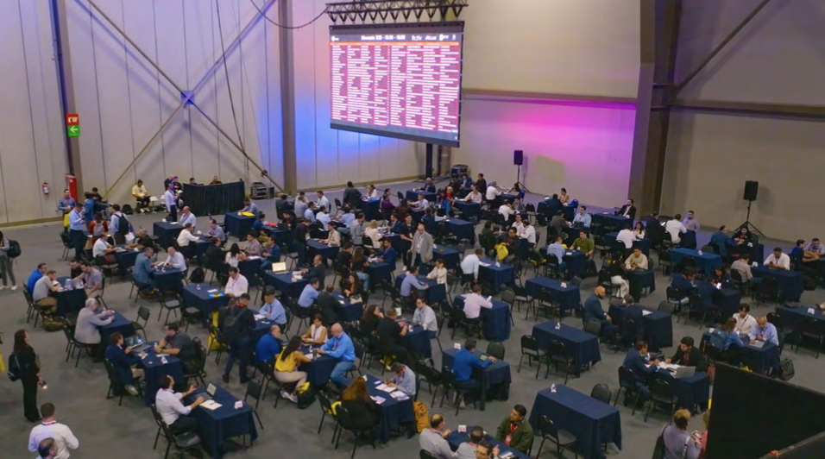
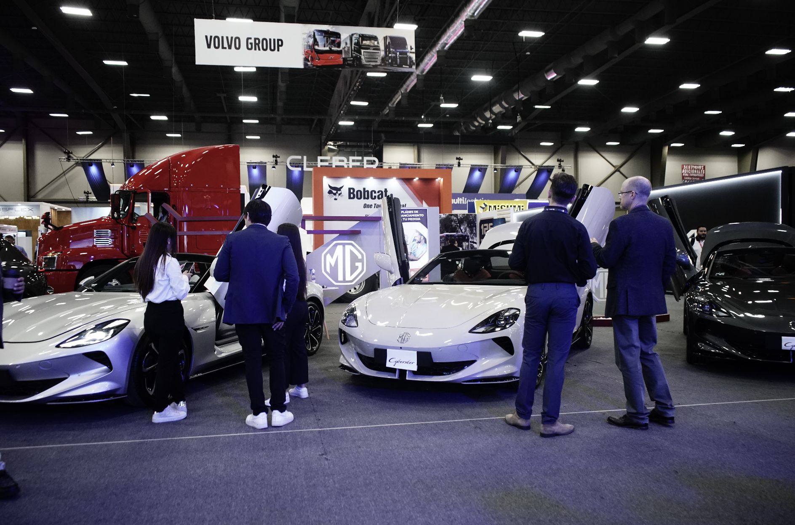
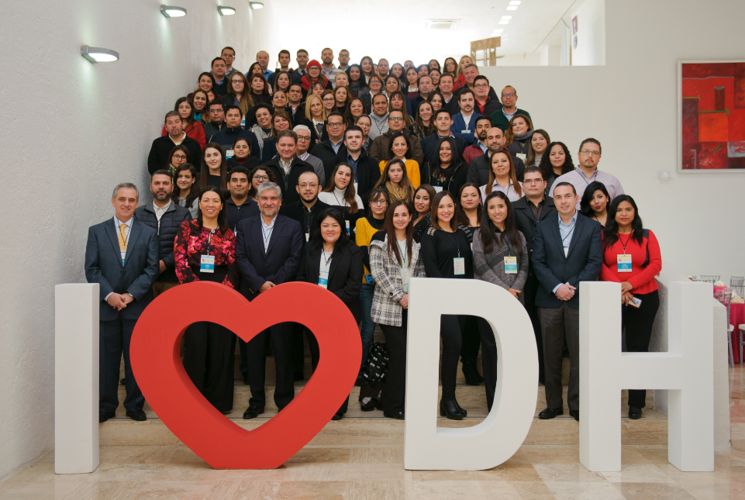
ICONIC EVENTS
Since: 2011 | Editions: 15
Since 2023 | Editions: 3
Since: 2014 | Editions: 12
One of the most prestigious Business Convention specialized in the automotive industry supply chain in the Mexican market.
The most important future mobility event in Mexico and Latin America annually since 2023 (formerly Mainforum from 2014 to 2022)
Congress that brings together experts from 3 top Mexican universities, in order to offer cutting-edge updates to Human Talent management professionals.

Slide 19

MEMBERSHIP OPTIONS
1
2
3
    OEM
    Tier 1
    Tier 2
  Tier 2
  Transnational (Companies with limited operations in the region)
    Tier 2
Associated
Affiliated
Affiliated
(Large companies)
COMMITTEES
Tier 2
Tier 2 - Trade
Tier 2 – Human Development
4 more committees or subcommittees to choose (*)
INVESTMENT
$121,750 MXN + TX
COMMITTEES:
All Committees(*)
OTHER BENEFITS:
Right to vote in Assembly
Possibility of belonging to the Board of Directors
INVESTMENT
$274,170 MXN + TX
COMMITTEES:
Tier 2
Tier 2 - Trade
Tier 2 – Human Development
Finance Committee (webinars and conferences)
INVESTMENT
$70,650 MXN + TX
ADDITIONAL BENEFIT: Our members have the possibility to obtain AIAG membership for free.

Slide 20
Additional Information:
www.claut.com.mx
MIGUEL BRAVO
Commercial Manager
miguel.bravo@claut.com.mx
+52 81 8335 1087 | +52 81 1017 1209

